Slide 1
Threads & Concurrency Lecture 4 Threading Issues & Examples
David Liu
Fall 2021, Spring 2022

Slide 2
Treading Issues
Fork() and exec() meaning
Which thread(s) handle a notification signal
Which thread to cancel
Thread-local storage
Communication between user-thread library and kernel

Slide 3
Operating System Examples
Windows Threads
Linux Threads

Slide 4
Fork and Exec
If a thread calls fork or exec
fork(): create a new process, two possibilities for thread creation
Duplicate only the calling thread
Duplicate all threads
exec
Replacing the running process including all threads

Slide 5
Signal handling
A signal is used in UNIX system to notify a process that a particular event has occurred
synchronous or asynchronous
Default or user-defined handler

Slide 6
Signal handling
Complex in multithreading environment
To the thread to which signal applies
To every thread in the process
To certain threads in the process
To a specific thread for all signals for the process
Signal delivered to a process or a thread
A thread can accept or block a signal

Slide 7
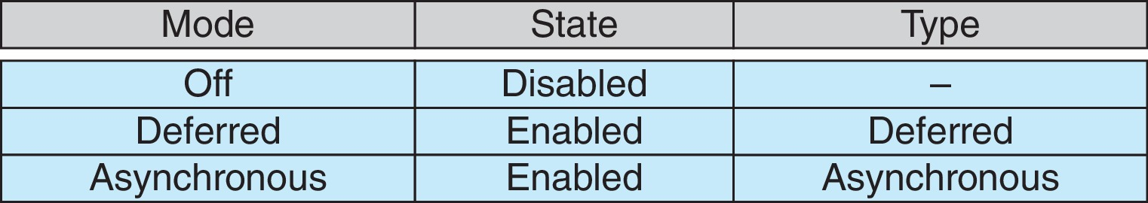
Thread Cancellation
Asynchronous cancellation terminates the target thread immediately
Deferred cancellation allows the target thread to periodically check if it should be cancelled (pthread_testcancel())
Invoking thread cancellation requests cancellation, but actual cancellation depends on thread state

Slide 8
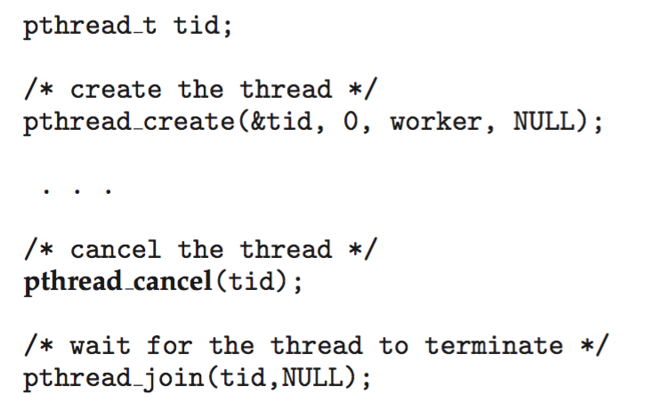
Thread Cancellation
Invoking thread cancellation requests cancellation, but actual cancellation depends on thread state
/* thread */
while (1) {
/* do some work for awhile */
…..
/* check if there is a cancellation request */
pthread_testcancel();
}

Slide 9
Thread-Local Storage
Thread-local storage (TLS) allows each thread to have its own copy of data
Useful when you do not have control over the thread creation process (i.e., when using a thread pool)
Different from local variables
Local variables visible only during single function invocation
TLS visible across function invocations
Similar to static data
TLS is unique to each thread

Slide 10
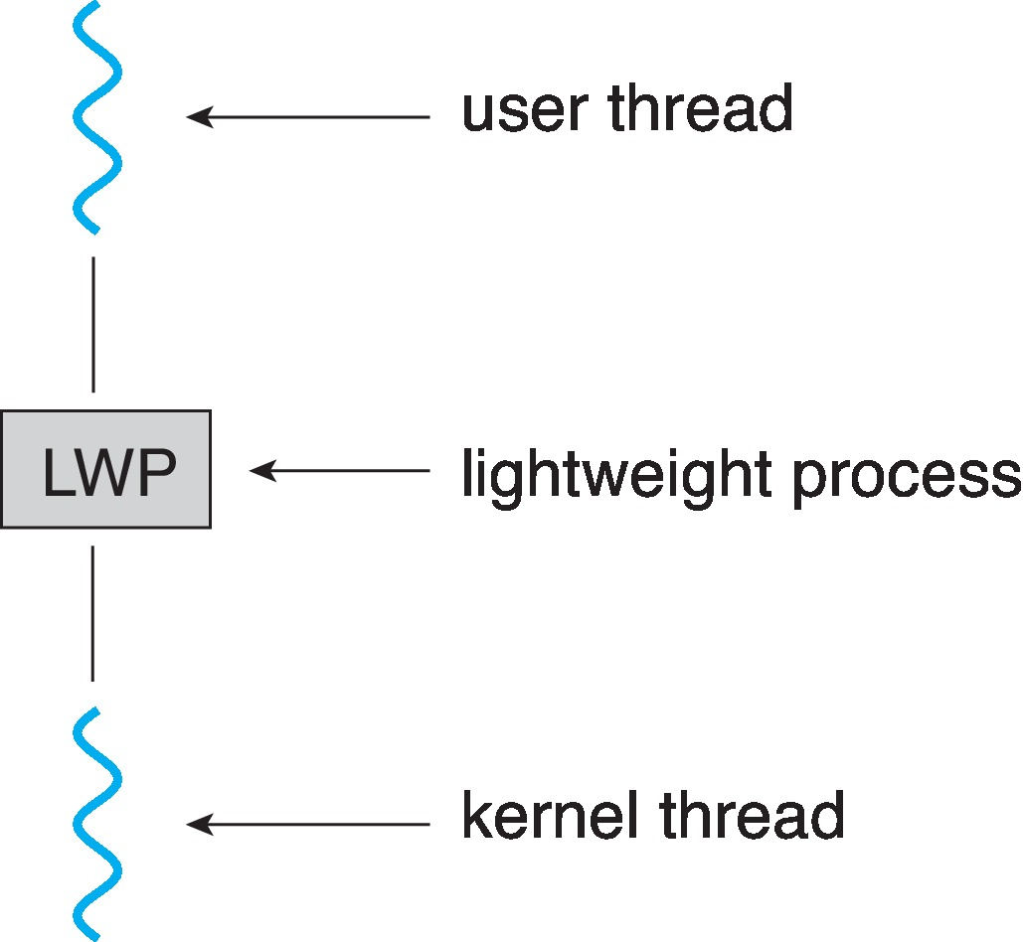
Scheduler Activations
Both M:M and Two-level models require communication to maintain the appropriate number of kernel threads allocated to the application
Scheduler activations provide upcalls - a communication mechanism from the kernel to the upcall handler in the thread library
This communication allows an application to maintain the correct number kernel threads
Upcall: a thread is blocking (for file)
Allocate a new LWP
Upcall handler runs on the new LWP:
save blocking thread state and relinquish its LWP
Schedule another thread to run on the new LWP

Slide 11
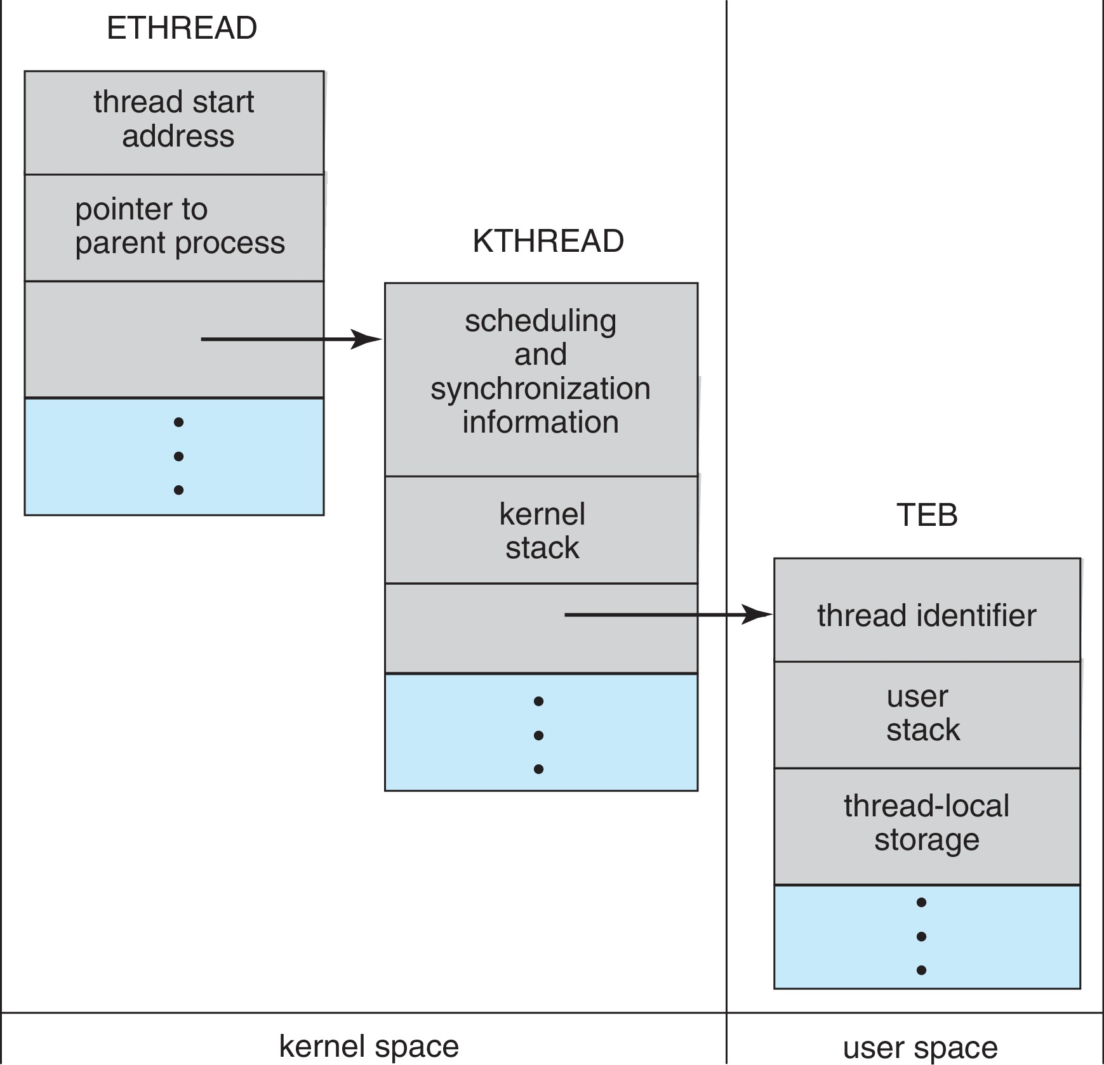
Windows Threads
User thread and Kernel-level thread: 1 to 1
Thread context: register set, stacks (user & kernel), private storage area
Data Structure for each thread includes
ETHREAD (executive thread block) – includes pointer to process to which thread belongs and to KTHREAD, in kernel space
KTHREAD (kernel thread block) – scheduling and synchronization info, kernel-mode stack, pointer to TEB, in kernel space
TEB (thread environment block) – thread id, user-mode stack, thread-local storage, in user space

Slide 12
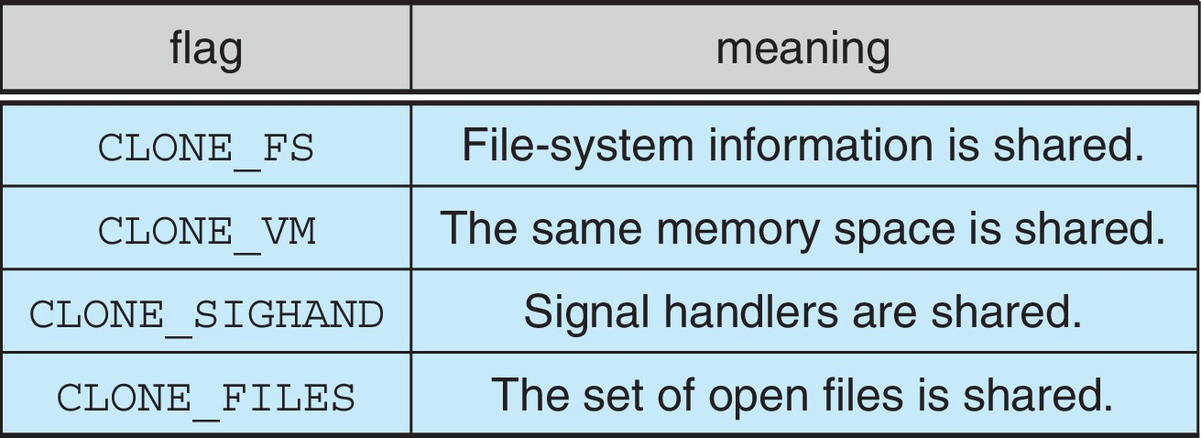
Linux Threads
Create a child process
fork()
Copies all the associated data structures of the parent task
Create a thread:
clone()
allows a child task to share the address
space of the parent task (process)
Points to the data structure of the parent task
struct task_struct points to process data structures (shared or unique)

Slide 13
Linux Process and Thread Creation
Create a child process or a thread?
clone(childFunc)
clone(childFunc, CLONE_FS | CLONE_VM | CLONE_SIGNAL | CLONE_FILES)

